Slide 1
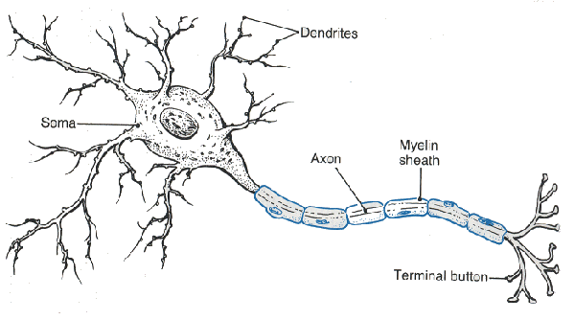
Chapter 9
http://www.youtube.com/watch?v=i-NgGKSNiNw
The Nervous System

Slide 2
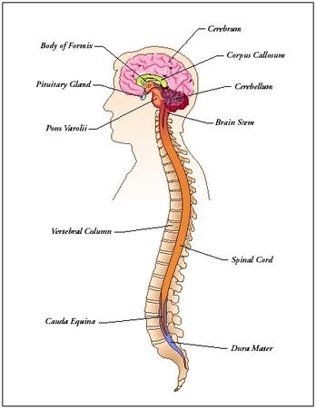
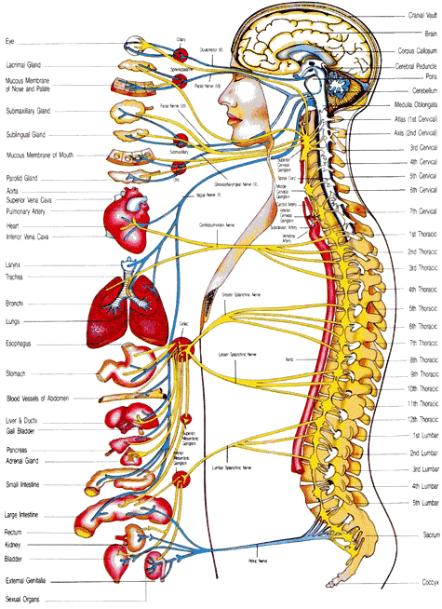
Introduction
2 divisions
Central Nervous System
CNS
Brain and Spinal Cord
Peripheral Nervous System
PNS
Nerves of the body that connect it to the CNS

Slide 3
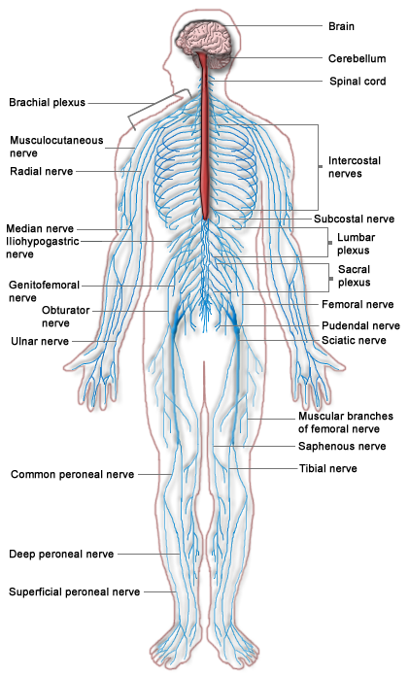
Introduction
Both CNS and PNS
Provide sensory, integrative, and motor functions
Nervous Tissue
Neurons
structural and functional units of nervous system
Neuroglial Cells
http://www.youtube.com/watch?v=sQKma9uMCFk

Slide 4
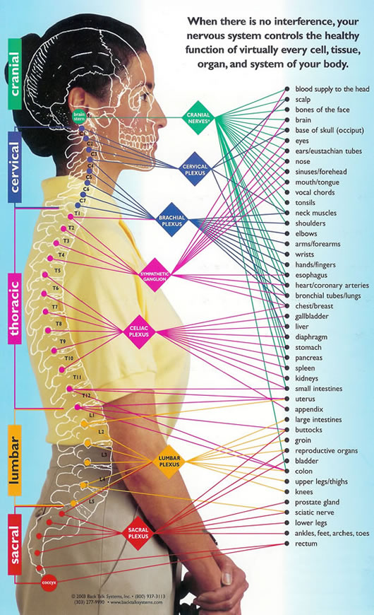
General Functions of the Nervous Systems
Sensory functions employ receptors that detect internal and external changes
Integrative functions collect sensory information and make decisions that motor functions carry out
Motor functions stimulate effectors to respond

Slide 5
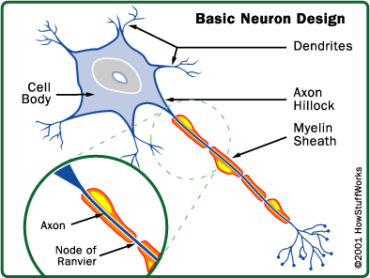
Neuron Structure
Neuron-Structural and Functional Unit
Consists of:
Cell body
Nerve fiber
Organelles
Dendrites and the cell body provide receptive surfaces
A single AXON arises from the
cell body and may be enclosed
in a myelin sheath and a neurilemma.

Slide 6
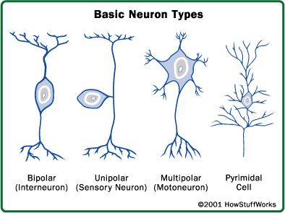
Types of Neurons
Classification of Neurons
On the basis of structure:
Multipolar
Bipolar
Unipolar
On the basis of Function:
Sensory neurons
Interneurons
Motor neurons

Slide 7
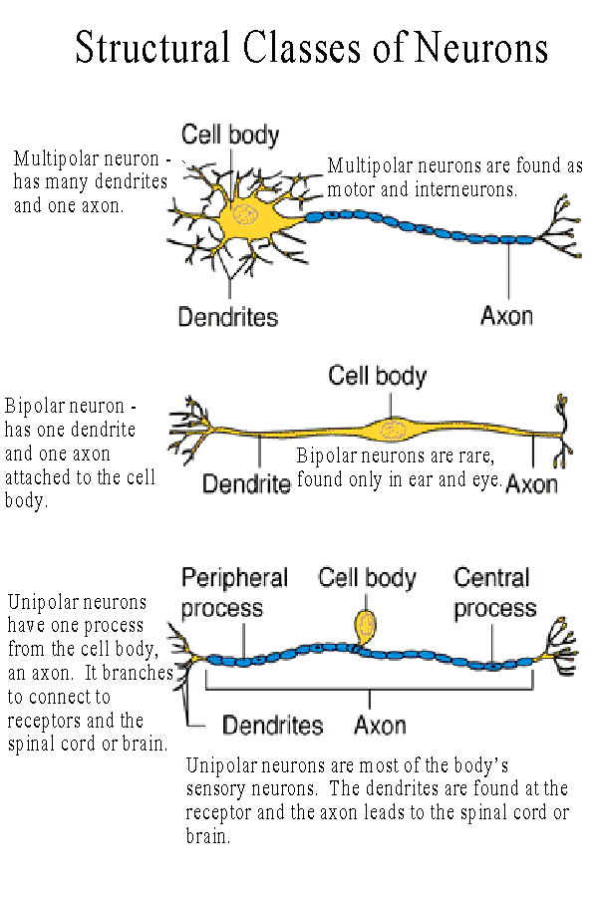

Slide 8
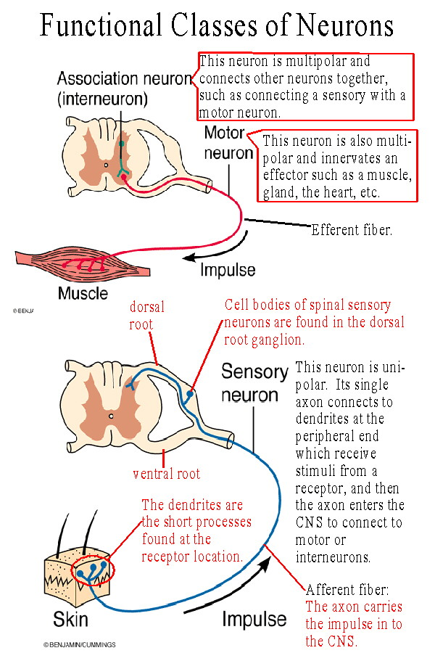

Slide 9
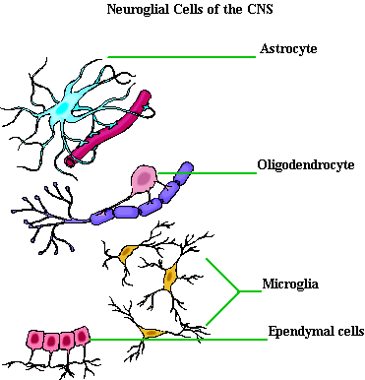
Types of Neuroglial Cells
Neuroglial Cells
Assessory cells
Function:
Fill spaces, support neurons, hold nervous tissue togther, produce myelin, help regulate the concentrations of nutrients and ions, carry on phagocytosis
Types:
Schwann Cells
Astrocytes
Oligodendrocytes
Microglial cells
Ependymal cells

Slide 10
Short Answer Review
What is the difference between a neuron and a neuroglial cell?
Explain how neurons are classified according to structure or function.
Name and describe four types of neuroglial cells
What are some functions of neuroglial cells.

